Slide 1

ONLINE CLASS
GRAPH THEORY
BICTE $6^{TH}$ SEMESTER
2078/02/11
PRESENTED BY KALYAN DAHAL

Slide 2
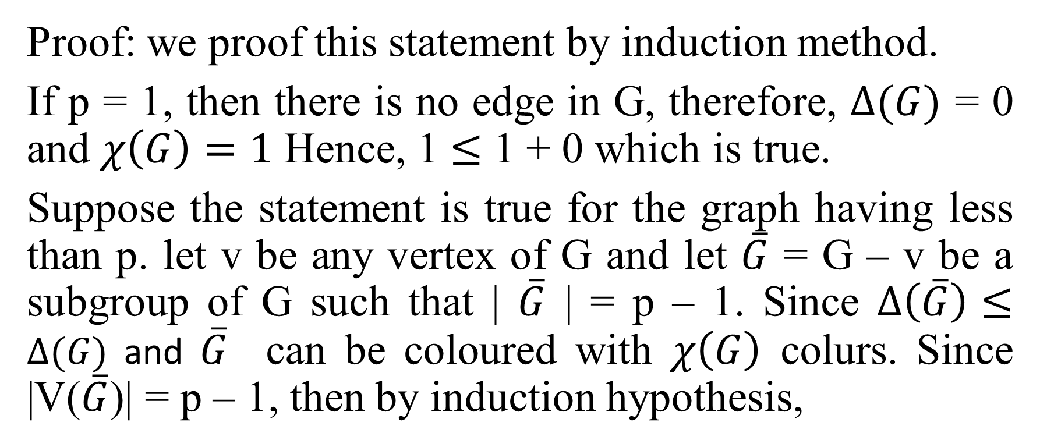
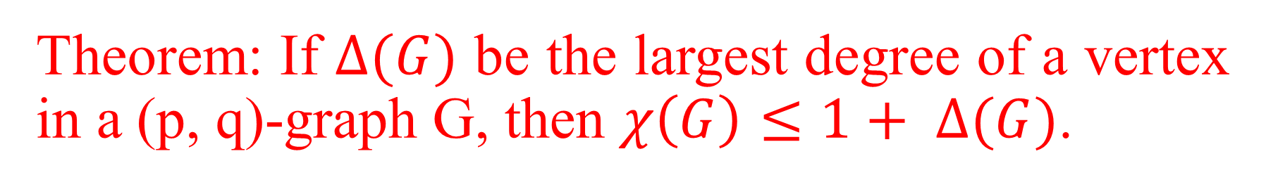
Theorem: If $∆(G)$ be the largest degree of a vertex in a (p, q)-graph G, then $χ\left(G\right)≤1+ ∆(G)$.
Proof: we proof this statement by induction method.
If p = 1, then there is no edge in G, therefore, $∆(G)$ = 0 and $χ\left(G\right)=1$ Hence, 1 $≤$ 1 + 0 which is true.
Suppose the statement is true for the graph having less than p. let v be any vertex of G and let $\overline{G}$ = G – v be a subgroup of G such that | $\overline{G}$ | = p – 1. Since $∆\left(\overline{G}\right)≤$ $∆(G)$ and $\overline{G}$ can be coloured with $χ\left(G\right)$ colurs. Since |V($\overline{G}$)| = p – 1, then by induction hypothesis,

Slide 3
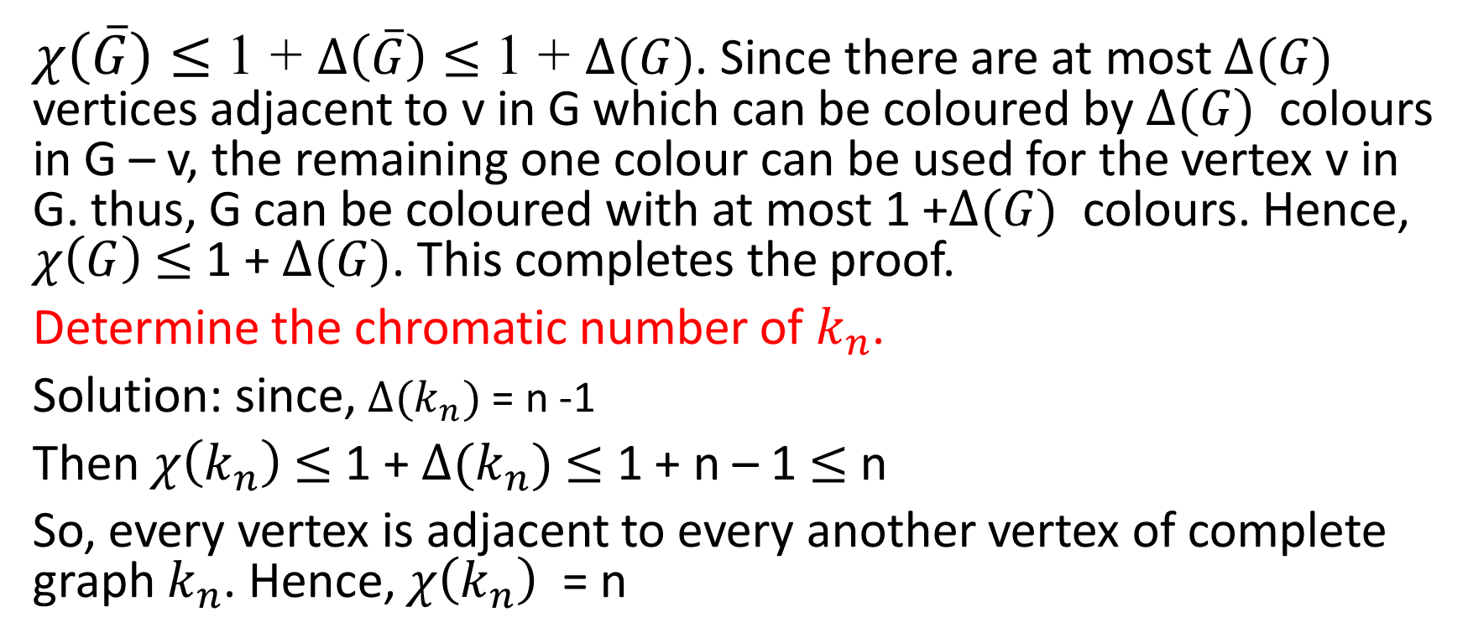
Continued….
$χ\left(\overline{G}\right)≤$ 1 + $∆\left(\overline{G}\right)≤$ 1 + $∆(G)$. Since there are at most $∆(G)$ vertices adjacent to v in G which can be coloured by $∆(G)$ colours in G – v, the remaining one colour can be used for the vertex v in G. thus, G can be coloured with at most 1 +$∆(G)$ colours. Hence, $χ\left(G\right)$ $≤$ 1 + $∆(G)$. This completes the proof.
Determine the chromatic number of $k_{n}$.
Solution: since, $∆(k_{n})$ = n -1
Then $χ\left(k_{n}\right)$ $≤$ 1 + $∆(k_{n})$ $≤$ 1 + n – 1 $≤$ n
So, every vertex is adjacent to every another vertex of complete graph $k_{n}$. Hence, $χ\left(k_{n}\right)$ = n

Slide 4
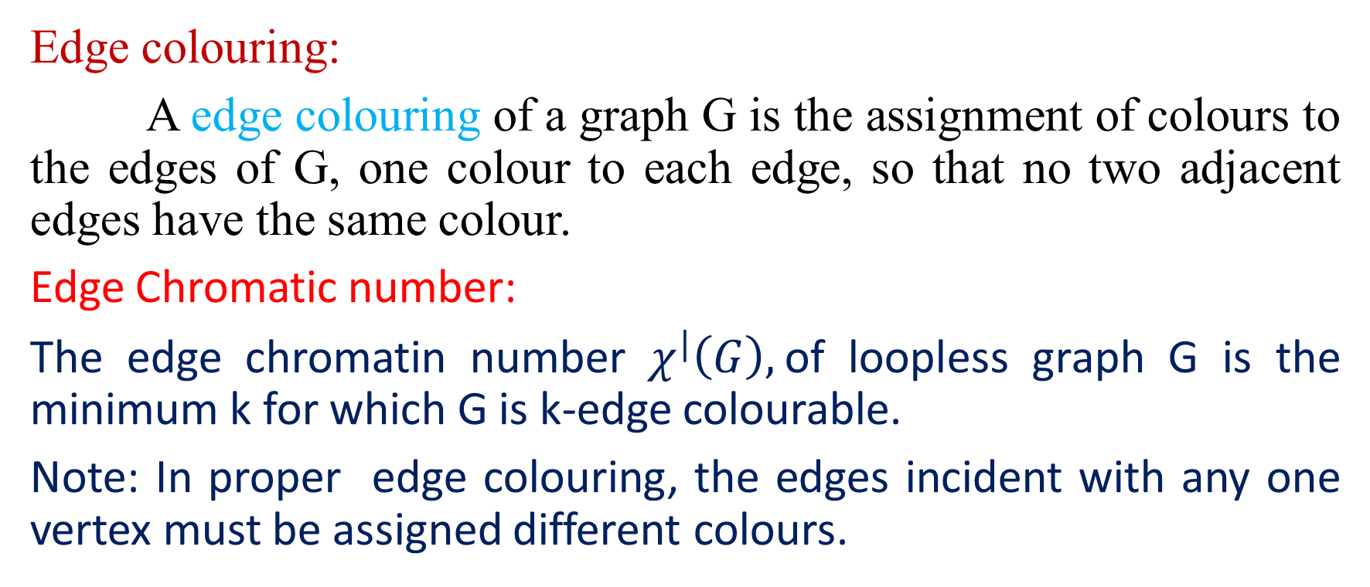
Edge colouring
Edge colouring:
A edge colouring of a graph G is the assignment of colours to the edges of G, one colour to each edge, so that no two adjacent edges have the same colour.
Edge Chromatic number:
The edge chromatin number $χ^{|}\left(G\right),$of loopless graph G is the minimum k for which G is k-edge colourable.
Note: In proper edge colouring, the edges incident with any one vertex must be assigned different colours.

Slide 5
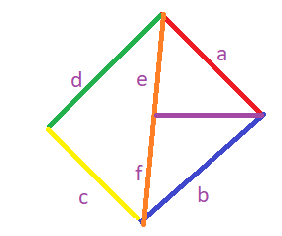
Continued…

Slide 6
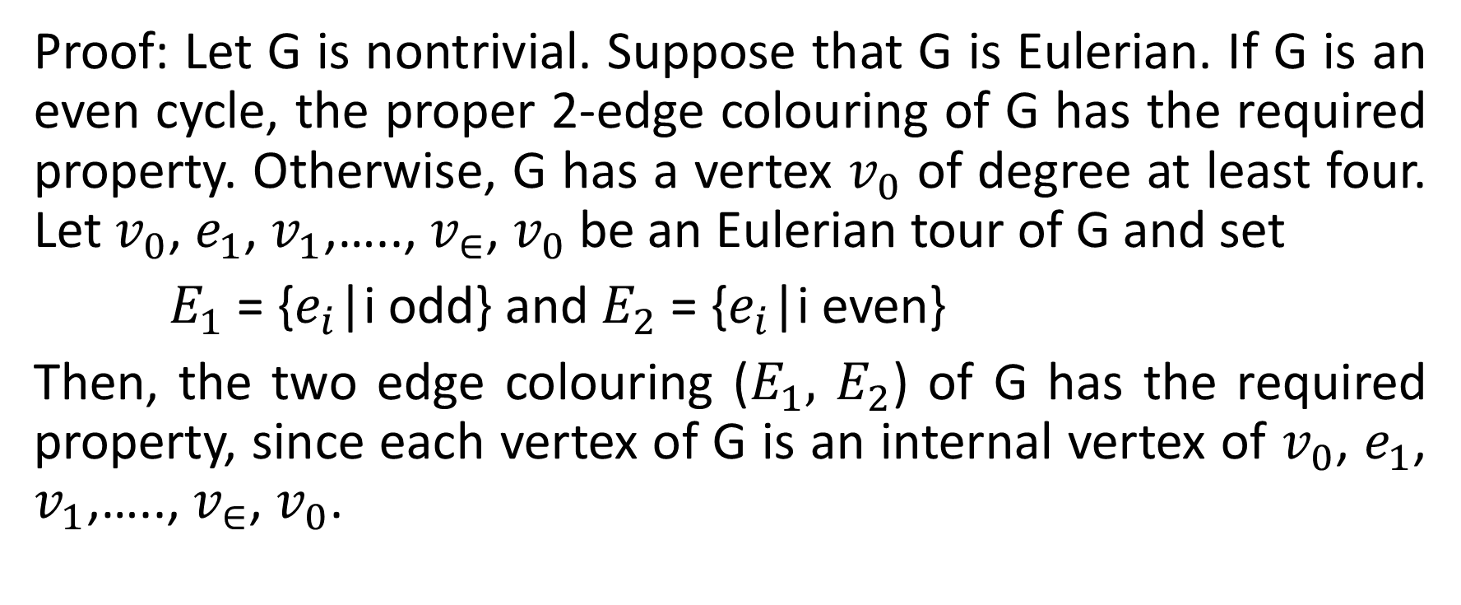
Lemma: Let G be a connected graph that is not an odd cycle .Then, G has a 2-edge colouring in which both colours are represented at each vertex of degree at least two.
Proof: Let G is nontrivial. Suppose that G is Eulerian. If G is an even cycle, the proper 2-edge colouring of G has the required property. Otherwise, G has a vertex $v_{0}$ of degree at least four. Let $v_{0}$, $e_{1}$, $v_{1}$,….., $v_{∈}$, $v_{0}$ be an Eulerian tour of G and set
$E_{1}$ = {$e_{i}$|i odd} and $E_{2}$ = {$e_{i}$|i even}
Then, the two edge colouring ($E_{1},$ $E_{2}$) of G has the required property, since each vertex of G is an internal vertex of $v_{0}$, $e_{1}$, $v_{1}$,….., $v_{∈}$, $v_{0}$.

Slide 7
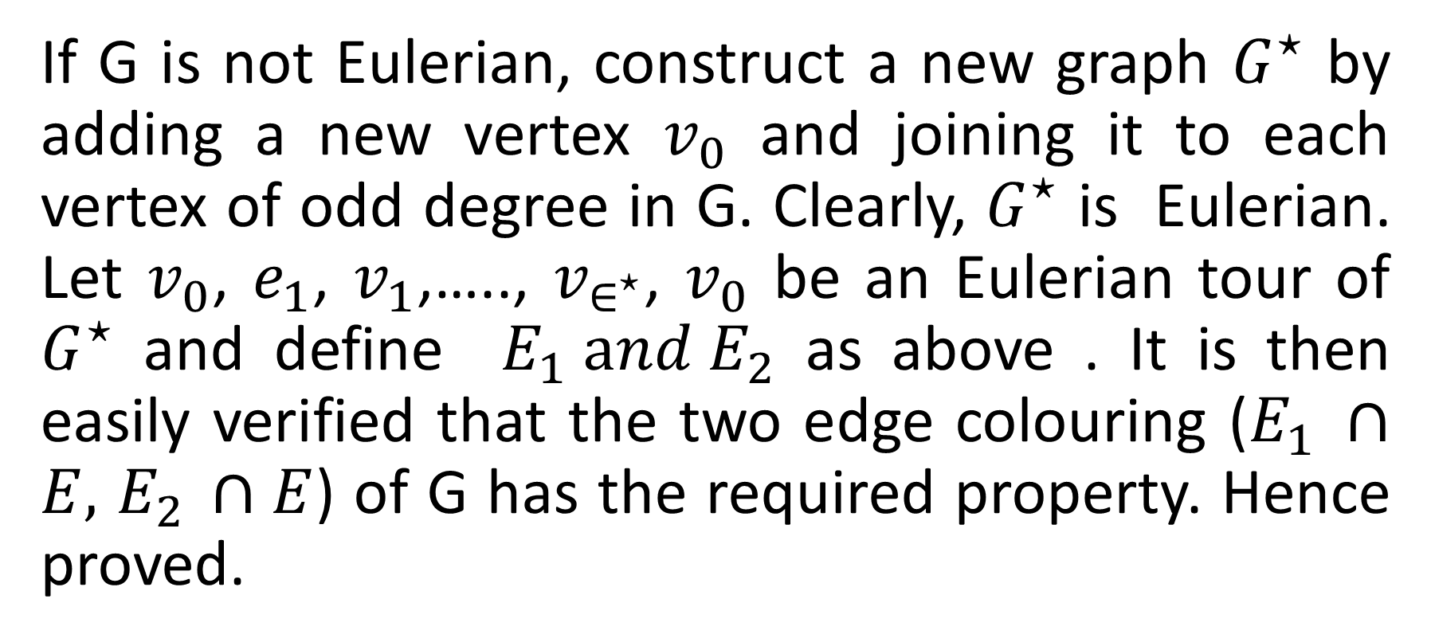
Continued…..
If G is not Eulerian, construct a new graph $G^{⋆}$ by adding a new vertex $v_{0}$ and joining it to each vertex of odd degree in G. Clearly, $G^{⋆}$ is Eulerian. Let $v_{0}$, $e_{1}$, $v_{1}$,….., $v_{∈^{⋆}}$, $v_{0}$ be an Eulerian tour of $G^{⋆}$ and define $E_{1} and E_{2}$ as above . It is then easily verified that the two edge colouring ($E_{1} ∩E,$ $E_{2 }∩E$) of G has the required property. Hence proved.

Slide 8
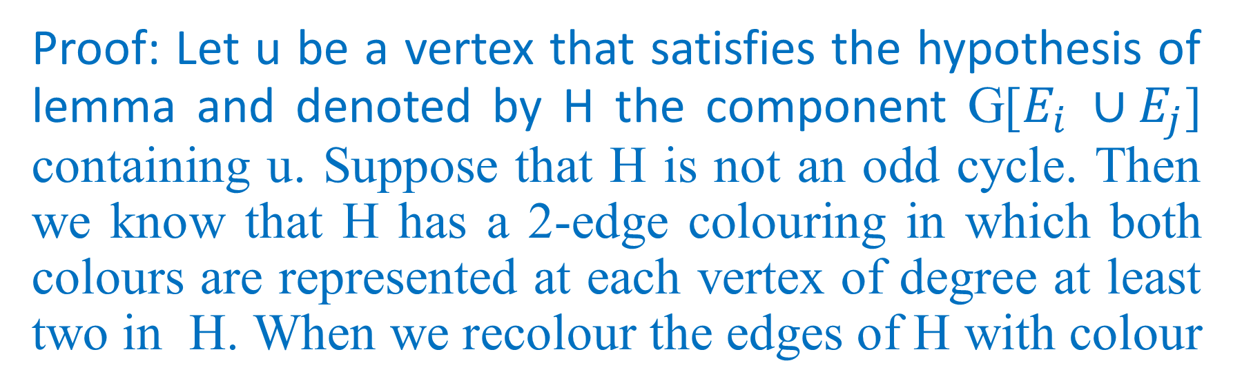
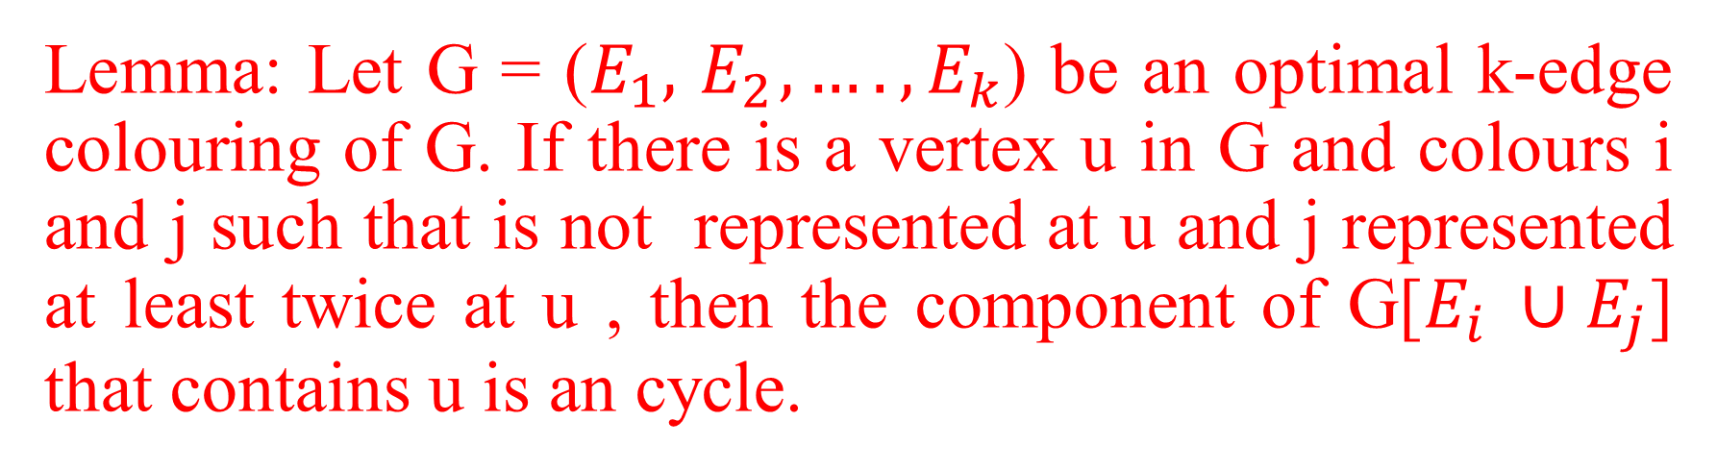
Lemma: Let G = ($E_{1},{ E}_{2},….,E_{k}$) be an optimal k-edge colouring of G. If there is a vertex u in G and colours i and j such that is not represented at u and j represented at least twice at u , then the component of G[$E_{i} ∪E_{j}$] that contains u is an cycle.
Proof: Let u be a vertex that satisfies the hypothesis of lemma and denoted by H the component G[$E_{i} ∪E_{j}$] containing u. Suppose that H is not an odd cycle. Then we know that H has a 2-edge colouring in which both colours are represented at each vertex of degree at least two in H. When we recolour the edges of H with colour

Slide 9
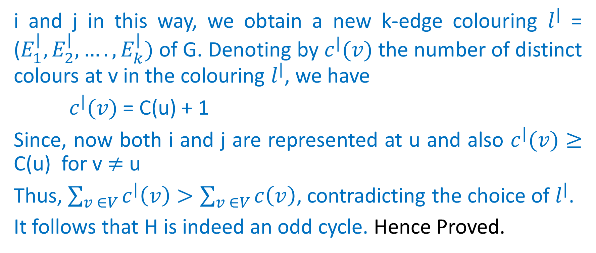
Continued…..
i and j in this way, we obtain a new k-edge colouring $l^{|}$ = ($E_{1}^{|},E_{2}^{|}, ….,E_{k}^{|})$ of G. Denoting by $c^{|}(v)$ the number of distinct colours at v in the colouring $l^{|}$, we have
$c^{|}(v)$ = C(u) + 1
Since, now both i and j are represented at u and also $c^{|}(v)$ $≥$ C(u) for v $≠$ u
Thus, $\sum_{v ∈V}{c^{|}\left(v\right)}>\sum_{v ∈V}{c\left(v\right)}$, contradicting the choice of $l^{|}$.
It follows that H is indeed an odd cycle. Hence Proved.

Slide 10
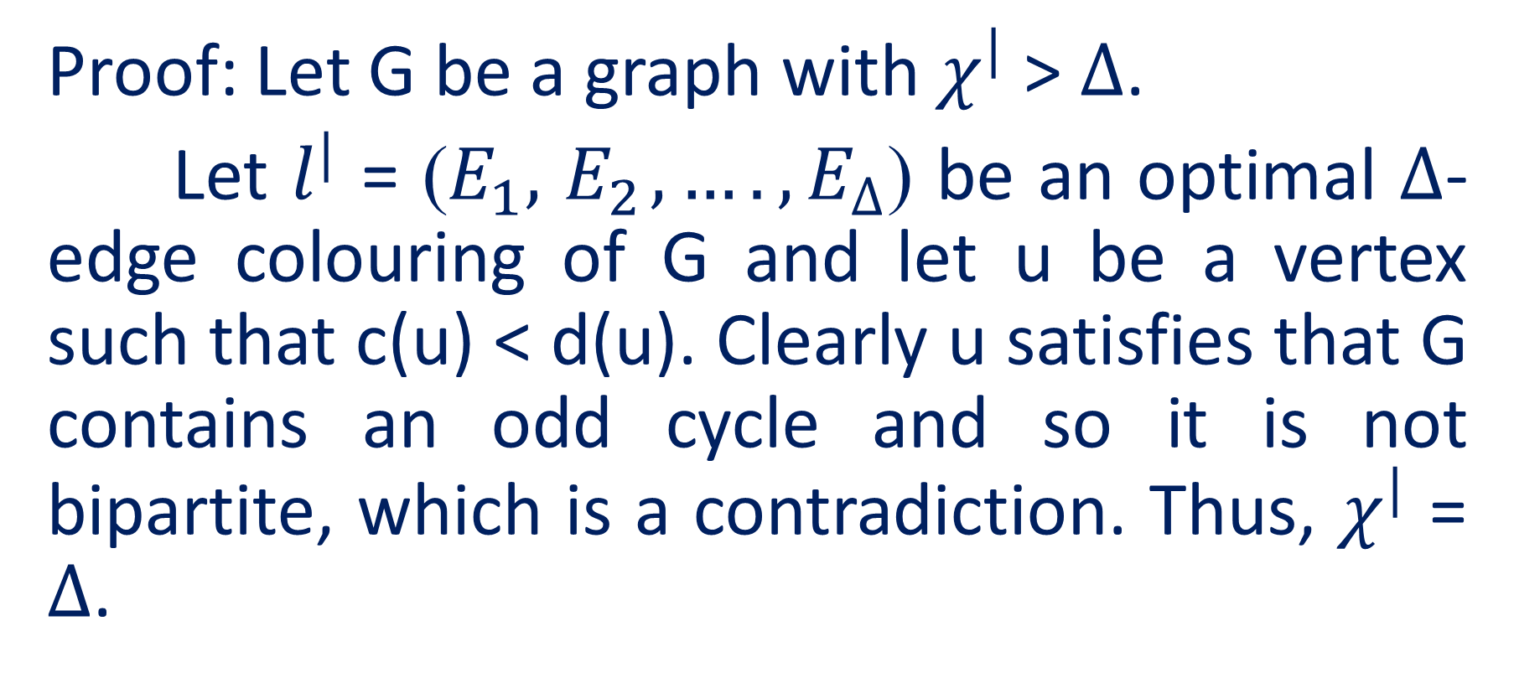
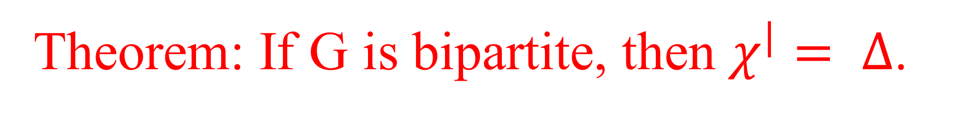
Theorem: If G is bipartite, then $χ^{|}= ∆$.
Proof: Let G be a graph with $χ^{|}$ > $∆$.
Let $l^{|}$ = ($E_{1},{ E}_{2},….,E_{∆}$) be an optimal $∆$-edge colouring of G and let u be a vertex such that c(u) < d(u). Clearly u satisfies that G contains an odd cycle and so it is not bipartite, which is a contradiction. Thus, $χ^{|}$ = $∆$.

Slide 11
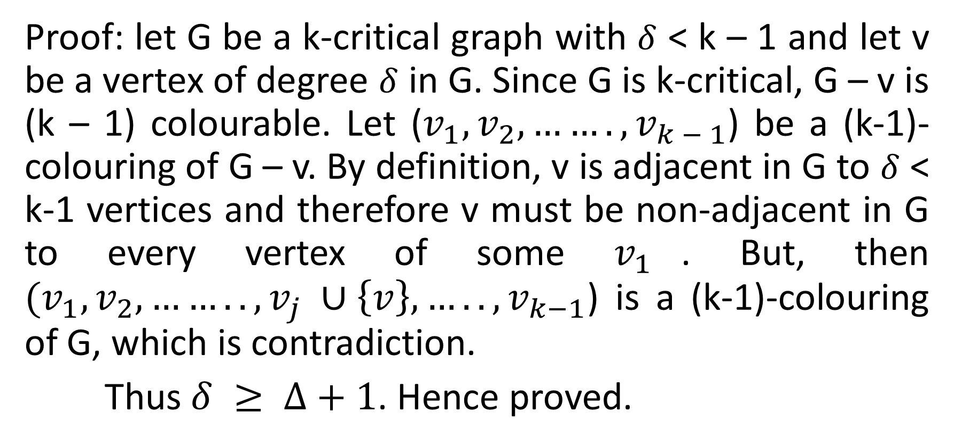

If G is k-critical, then $δ ≥ ∆+1.$
Proof: let G be a k-critical graph with $δ$ < k – 1 and let v be a vertex of degree $δ$ in G. Since G is k-critical, G – v is (k – 1) colourable. Let ($v_{1},v_{2}, …….,v_{k − 1}$) be a (k-1)-colouring of G – v. By definition, v is adjacent in G to $δ$ < k-1 vertices and therefore v must be non-adjacent in G to every vertex of some $v_{1}$. But, then $(v_{1},v_{2}, ……..,v_{j} ∪\left\{v\right\}, …..,v_{k−1}$) is a (k-1)-colouring of G, which is contradiction.
Thus $δ ≥ ∆+1$. Hence proved.

Slide 12


